Slide 1

B U S I N E S S T R A C K · P R I C I N G C A S E
Sahi Daam: The Right Price, from Day One
A Pricing Co-Pilot that helps new-to-online Meesho sellers find their true floor, price inside the market band, and keep the price right across the product's life
Team NoName | Deeksha Dey · Himanshi Vaidya · Aashish Gaurabh | IIT (ISM) Dhanbad
Notes:
Title. One line: Sahi Daam fixes the four pricing problems that hurt the most new sellers: wrong cost base, returns and RTO not priced in, copying the market, and setting a first price with no history.

Slide 2






Problem Statement
New sellers lose money on orders they think are profitable, and keep the wrong price for months
PROBLEM
SEGMENTATION
PRIORITISATION
BENCHMARKING
SOLUTION
MUNAFA METER
SMART BAND
AUTOPILOT
IMPACT
PITFALLS
Why pricing breaks today: the price-to-bank journey of a new-to-online seller
Seller sets price
Listing data
Buyer compares
Delivery outcome
Settlement
Offline price carried over, or cheapest competitor copied; 'cost' = purchase rate only
Weight and box size set the shipping slab; return option picked blindly
Near-identical listings side by side; a wrong slab inflates the price
72% COD; some parcels refused (RTO), some returned after delivery
Shipping + 18% GST on fees deducted: 'Meesho transfers less than I listed'
The root cause is one chain: four problems feed each other
Worked example: kurti set copying the ₹299 market price
P1
P4
P2
P3
−₹10.59
Per 100 dispatched orders | ₹
70 kept × ₹299 | +20,930
Product cost (kept) | −13,300
Shipping + GST (kept) | −5,369
15 RTOs (no reverse fee) | −225
15 customer returns | −2,295
Ads | −800
Profit | −1,059
Wrong cost base
Returns & RTO not priced in
Copies the market
No data to correct it
Anchors on cheapest or median price, below own floor
First price set blind; nothing tells the seller it is wrong
lost on every dispatched order
true floor ₹314 vs market ₹299
Shipping, GST on fees, packing ignored
Failed orders never enter the price
“Cost = purchase rate”
“~8–9 of 30 orders come back”
“If I increase ₹20, orders stop”
“Sheet price is useless”
A customer return costs ~₹153; an RTO ~₹15. Returns are the bigger leak.
4.47 lakh
~15 days
72%
15–20%
net new transacting sellers a year (961k ATS, +87%)
for a new seller to get the first order
of Meesho's shipped orders are cash on delivery
industry return rate; fashion 25–40%
Notes:
The case asks how a new seller should price. Our research says the problem is a chain: wrong cost base and missing returns give a wrong floor, so sellers copy the market, and with no data nothing corrects them. The kurti example comes from Workbook 03.

Slide 3
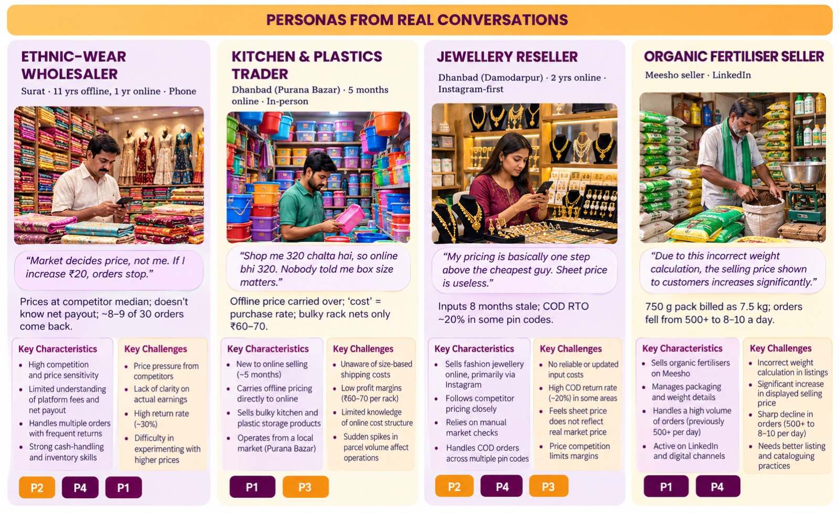




Segmentation & User Research
Who we spoke to, what we heard, and which sellers Sahi Daam serves first
PROBLEM
SEGMENTATION
PRIORITISATION
BENCHMARKING
SOLUTION
MUNAFA METER
SMART BAND
AUTOPILOT
IMPACT
PITFALLS
Research methods
5 seller conversations
1 LinkedIn · 3 In-person · 1 Phone call
Buyer survey (Google Form)
20 questions on price, COD, returns
33 published sources
Meesho FY26 results & RHP, GoKwik, Unicommerce, seller-fee guides
5-platform benchmark
Meesho, Amazon, Flipkart, Walmart, Temu
Segmentation: Pricing Literacy × Online Maturity
New online,
high literacy
Experienced online,
high literacy
Growing tier
Pro tier
New online, low literacy
→ LAUNCH SEGMENT
Experienced online,
low literacy
Guided tier
Growing tier
Notes:
All four personas are real conversations from Round 1. Tallies are small-n and update automatically in Workbook 02 as interviews are added. Launch segment: new-to-online, low pricing literacy sellers in fashion and home categories in Tier-2 supply hubs, served by the Guided tier.

Slide 4
Prioritisation of Problems
Reach × Impact scoring on 5 factors: four problems stand out, and the whole solution focuses on them
PROBLEM
SEGMENTATION
PRIORITISATION
BENCHMARKING
SOLUTION
MUNAFA METER
SMART BAND
AUTOPILOT
IMPACT
PITFALLS
# | Problem | Breadth | Frequency | Loss / order | Churn risk | Meesho impact | Reach | Impact | R × I | Tier
P4 | Returns & RTO not priced in | 4 | 5 | 5 | 4 | 5 | 4.5 | 4.67 | 21.0 | Core
P1 | Wrong cost base | 4 | 5 | 5 | 4 | 4 | 4.5 | 4.33 | 19.5 | Core
P3 | First price with no history | 5 | 4 | 4 | 4 | 4 | 4.5 | 4.00 | 18.0 | Core
P2 | Copying cheapest / median price | 4 | 4 | 4 | 4 | 4 | 4.0 | 4.00 | 16.0 | Core
P5 | Weight error moves shipping slab | 2 | 4 | 5 | 5 | 3 | 3.0 | 4.33 | 13.0 | Additional
P7 | Unclear settlements & generic support | 3 | 4 | 2 | 4 | 3 | 3.5 | 3.00 | 10.5 | Additional
P6 | Stale prices over product life | 3 | 3 | 3 | 3 | 3 | 3.0 | 3.00 | 9.0 | Additional*
P10 | Low conversion misread as price | 3 | 3 | 2 | 3 | 3 | 3.0 | 2.67 | 8.0 | Additional
P9 | Unviable bulky SKUs | 2 | 3 | 4 | 3 | 2 | 2.5 | 3.00 | 7.5 | Additional
P8 | Season-end dead stock | 2 | 2 | 4 | 4 | 2 | 2.0 | 3.33 | 6.7 | Additional
P11 | Customer fraud (used / fake returns) | 2 | 2 | 3 | 3 | 4 | 2.0 | 3.33 | 6.7 | Roadmap
CORE · score ≥ 16
ADDITIONAL
ROADMAP
P4 · P1 · P3 · P2
P5 · P7 · P6* · P10 · P9 · P8
P11
Scoring (1–5 each)
Reach = Average of Breadth (share of new sellers affected) and Frequency (every order vs occasional).
Impact = Average of Loss per order (₹ hit to the seller), Churn risk (does it push sellers to quit) and Meesho impact (GMV, RTO cost, trust).
R × I out of 25.
Munafa Meter (P1 + P4) and Smart Band (P2 + P3)
Built as checks inside the core features.
Customer fraud is real but an operations problem, not pricing
Notes:
Mentor asked us to focus. Each problem is scored 1-5 on five factors: two for reach (breadth, frequency) and three for impact (loss per order, churn risk, Meesho impact). The top four score 16 or more; the next is 13. Founder's Handbook: about three features are enough to test product-market fit.

Slide 5



Competitive Benchmarking
No platform builds a price floor from the seller's own cost and expected returns
PROBLEM
SEGMENTATION
PRIORITISATION
BENCHMARKING
SOLUTION
MUNAFA METER
SMART BAND
AUTOPILOT
IMPACT
PITFALLS
Platform | P1 · Floor from seller's own cost | P4 · Returns & RTO priced in | P2 · Market band shown | P3 · First-price help | Lifecycle signals
Meesho (today) | No Price Recommendation is competitor-led | Partial Dual price for defective-only returns | Yes Recommended price + transfer price | Partial Recommendation, but no cost floor | Partial Smart pricing within seller min/max
Amazon | Partial Revenue Calculator; seller enters cost | No Not in the price guidance | Yes Pricing Health vs Featured Offer | Partial Calculator only | Partial Automate Pricing rules
Flipkart | No Market-trend based | No Not in the price guidance | Yes Price Recommendation Tool | Partial Help via paid account manager | No Dashboards only
Walmart Marketplace | Partial Mandatory seller-set minimum price | No Not in the price guidance | Yes Pricing Insights, Buy Box win rate | No None found | Partial Repricer within min/max
Temu (fully managed) | n/a Platform sets the retail price | n/a Platform carries returns | n/a Platform decides | n/a Platform decides | n/a Platform decides
Sahi Daam | Yes Munafa Meter: C + shipping + GST + failures | Yes RTO and returns priced separately | Yes Band + zones + price rank, never below floor | Yes Category priors blended with own data | Yes 3 triggers with ₹ impact
2025–26 shift
Amazon moved to 0% referral fee up to ₹1,000 (Mar 2026); Flipkart to zero commission below ₹1,000 (Nov 2025). 'Zero commission' is no longer Meesho's unique edge: competition moves to seller tools.
The opposite extreme
Temu's fully managed model sets the price for the seller. Sahi Daam sits in between: Meesho supplies the floor, band and signals; the seller decides.
The gap Sahi Daam fills
Every platform shows a market price. None starts from the seller's true cost to serve a delivered order, including RTO and returns: the exact gap behind P1 and P4.
Notes:
We compare only on the four needs we prioritised, plus lifecycle signals. Yes / Partial / No is based on public seller help pages and our Round 1 review; the rubric and links sit in the appendix. The key message is the empty 'floor from own cost' column.

Slide 6






Proposed Solution
Sahi Daam: a pricing co-pilot inside the Supplier Panel, built on Floor → Ceiling → Position
PROBLEM
SEGMENTATION
PRIORITISATION
BENCHMARKING
SOLUTION
MUNAFA METER
SMART BAND
AUTOPILOT
IMPACT
PITFALLS
1 · FLOOR
What must every order cover?
2 · CEILING
What will buyers pay?
3 · POSITION
Where in the band?
P₀ = C + S + (f·F + A) ÷ (1 − f)
Band = Q1 → Q3 of comparable listings
Suggested = min(max(ε/(ε−1)·P₀, P₀), Q3)
C= landed cost,
S= shipping + fees + GST,
f =RTO + return share
F =blended cost per failed order,
A =ads
Not just the cheapest; offline price is a sanity check only
ε represents the price elasticity of demand — basically, how sensitive buyers are to a change in price.
Higher ε → buyers are more price-sensitive.
Lower ε → buyers are less price-sensitive.
Three features, one seller journey
Seller journey and tiers
Munafa Meter
Smart Band
Lifecycle Autopilot
List
Price
Test
Grow
Clear
True floor from cost, shipping + GST, RTO vs return cost and ads; weight check before saving
Band with Loss / Win / Profit zones vs own floor, price rank, suggested range, first-price mode
3 triggers (launch screen, cost change, season end), one ₹-explained nudge at a time
Guided: voice + Hindi, defaults, one-line ₹ answer (launch segment)
Growing: band, sliders, price tests
Pro: bulk SKUs, custom rules, exports
Kurti floor ₹314: ₹299 loses ₹10.59 / order
₹299 sits in the Loss zone; suggested ₹319
Season P&L −₹21,872 → +₹1,698
End-to-end system architecture and operations
Data Meesho already holds
Seller inputs
Pricing engine
Touchpoints
Feedback loop
Rate card & slabs, category RTO / return rates, comparable listings · settlements
Purchase cost, packing, weight, box size (voice / Hindi)
Floor, band & suggested price, prior blending
Listing flow, price edit, WhatsApp / app nudges
Orders, returns, settlements update priors and floors
Working prototype: desktop web app (React + TypeScript) LINK
Notes:
Floor, ceiling, position stays as in Round 1. Founder's Handbook: the introductory price should be no profit, no loss, which is our floor. The next three slides go deep on each feature.

Slide 7
Munafa Meter
Feature 1 · The True Floor Price, before the product goes live
PROBLEM
SEGMENTATION
PRIORITISATION
BENCHMARKING
SOLUTION
MUNAFA METER
SMART BAND
AUTOPILOT
IMPACT
PITFALLS
About the feature
Wireframe (desktop prototype)
Value proposition
A cost wizard inside the listing flow. The seller types purchase cost and package size; Munafa Meter auto-fills the shipping slab, 18% GST on fees and category RTO / return rates, then shows the floor price and a price → bank → profit breakdown. A built-in weight check stops slab errors before they go live.
sahidaam.app (demo)
1
Floor price and the ₹ loss at the market price
For the seller
For Meesho
Sahi Daam
Munafa Meter
Smart Band
Autopilot
Start pricing
Know, in rupees and before listing, the lowest price that won't lose money, and which lever (returns, packing, sourcing) fixes a loss-making SKU.
Fewer loss-making listings and slab disputes, so fewer new sellers churn; every saved seller keeps generating ~₹47 revenue per order.
Costs
Your floor price
2
Slab and 18% GST on fees auto-filled from the rate card
Purchase
₹160
₹314
Packing
₹15
1
Pain points addressed
Labour
₹15
At ₹299 you lose ₹10.59 / order
3
Weight check flags a slab jump before saving (P5)
P1
Wrong cost base
Package
Product
₹190
Does this actually solve the problem?
“Shop me 320 chalta hai, so online bhi 320. Nobody told me box size matters.”
0.45 kg · 30×25×3 cm · zonal
Ship + GST
₹77
2
Slab 0–0.5 kg · ship + GST ₹76.70
Returns & RTO
₹36
4
What-if levers show which change makes the SKU viable
YES
It turns invisible per-order losses into a number the seller sees before the first order ships.
P4
⚠ 7.5 kg would jump to 5–10 kg slab
3
Ads
₹11
Returns & RTO not priced in
“~8–9 of 30 orders come back”; a customer return costs ~₹153, an RTO ~₹15
Returns (category data)
What if…
Check | Before | With feature
Loss visible before listing | Hidden | −₹10.59 / order shown
Kurti floor with size chart lever | ₹314 | ₹301
Profit at ₹299 after 3 levers | −₹10.59 | +₹13.51
750 g listed as 7.5 kg | Goes live | Flagged before save
RTO 15%
5
Defective-only returns
4
Size chart + photos
5
Category RTO / return rates, editable; RTO and returns costed separately
P5
Returns 15%
Smaller box
Floor ₹314 → ₹301
Weight error moves the slab
750 g pack billed as 7.5 kg; orders fell from 500+ to 8–10 a day
User flow
Enter cost
Add weight & box
Check returns
See floor & ₹ split
Pull lever, list
Why this feature
P4 and P1 have the two highest Reach × Impact scores (21.0, 19.5)
0 of 5 benchmarked platforms builds a floor from the seller's own cost and returns
A transparent formula earns trust; every number has a 'How we calculated this' panel
Uses data Meesho already holds: rate card, category priors
Benefits
System architecture
₹314
3.2×
Inputs
Engine
Outputs
Touchpoint
true floor shown on day 1 (kurti)
a return costs vs an RTO per point: the lever is clear
Seller: cost, weight, box, zone · Meesho: rate card, category priors
Billable kg → slab → S; RTO vs return cost; floor formula
Floor, min price, price → bank → profit, weight alert
Listing flow in Supplier Panel; floor feeds Smart Band
+₹24
0
per order swing after 3 levers (−₹10.59 → +₹13.51)
slab errors reaching buyers unchecked
Notes:
Wireframe is the desktop prototype. Numbers come from Workbooks 03 and 05. Does it solve P1 and P4: yes, because the seller sees the loss before listing and which lever fixes it.

Slide 8
Smart Band
Feature 2 · Where to Price against the Market, including the First Price with no Sales History
PROBLEM
SEGMENTATION
PRIORITISATION
BENCHMARKING
SOLUTION
MUNAFA METER
SMART BAND
AUTOPILOT
IMPACT
PITFALLS
About the feature
Wireframe (desktop prototype)
Value proposition
Shows where the seller's price sits among anonymous comparable listings: a band (Q1 – median – Q3) with Loss / Win / Profit zones marked against the seller's own floor, a price rank, a suggested price range that never goes below the floor, a one-line strategy and, for new listings, a first-price mode built on category data.
sahidaam.app (demo)
1
Seller's own floor from Munafa Meter splits Loss from Win
For the seller
For Meesho
Sahi Daam
Munafa Meter
Smart Band
Autopilot
Start pricing
Price with the market without pricing below your own cost, see how you rank, and get a defensible first price on day one.
Turns a competitor-led recommendation into a floor-aware one; ranges and seller choice keep it clear of price herding.
Kurti set
Floor ₹314
1
2
Band from anonymous comparable listings (Q1 – median – Q3)
Loss
Above band
2
Pain points addressed
Q1 ₹289
Median ₹299
Q3 ₹319
3
Price rank instead of rival names or volumes
P2
₹299 is cheaper than 48% of similar listings
3
Does this actually solve the problem?
Copying cheapest / median price
“My pricing is basically one step above the cheapest guy.” · “If I increase ₹20, orders stop.”
Suggested
4
Strategy
Confidence
5
4
Suggested range, never below floor, capped at Q3
YES
It replaces 'copy the cheapest' with 'price inside the band, above my floor', even for a brand-new listing.
₹314 → ₹319
Penetration
Category data
P3
keeps ₹3.41 / order
no ratings yet: floor+, step up after ~30 orders
0 orders · 50% own data at 30
Check | Before | With feature
₹299 copied from the market | Looks safe | Shown as Loss zone
Suggested price (ε = 15) | None | ₹319, keeps ₹3.41
Own-data weight at 30 orders | 0% | 50%
Suggestions below floor | Possible | Never
First price with no history
Every new seller sets a price blind; ~15 days to first order
5
First-price mode: category data, blended with own orders
Scenario sliders: price · returns · RTO · shipping · cost
Set ₹319
P9
Unviable bulky SKUs
Floor above the band even after levers → 'fix or drop' verdict
User flow
Why this feature
Floor from Meter
See band & zone
Pick strategy
Accept range
Own data refines
P3 reaches 100% of new sellers; P2 scores 16 on Reach × Impact
Every platform shows a market price; none marks it against the seller's own floor
Upgrades Meesho's existing Price Recommendation instead of replacing it
A range, never one target price, and the seller decides: avoids price-herding concerns (CCI 2025)
Small sellers can't learn price sensitivity alone; Meesho can pool it by category
Benefits
System architecture
Day 1
48%
Inputs
Engine
Outputs
Touchpoint
first price from category data, no history needed
price rank shown instead of rival names
Comparable listings, floor, category ε, ratings, own orders
Quartiles, zone, rank; min(max(ε/(ε−1)·P₀, P₀), Q3)
Band chart, suggested range, strategy, confidence meter
Price edit screen; upgrades Price Recommendation
₹319
50%
suggested price, capped at Q3
own data weight at 30 orders
Notes:
The band uses sample listings in the prototype; production would use Meesho's comparable-listing data. Numbers from Workbook 04.

Slide 9
Lifecycle Autopilot
Feature 3 · Keeps the Price right after Launch with 3 triggers and one nudge at a time
PROBLEM
SEGMENTATION
PRIORITISATION
BENCHMARKING
SOLUTION
MUNAFA METER
SMART BAND
AUTOPILOT
IMPACT
PITFALLS
About the feature
Wireframe (desktop prototype)
Value proposition
Watches each listing after it goes live and sends one nudge when a trigger fires: T1 launch screen (≤ half the expected orders after ~1,000 views), T2 cost change (slab, GST, purchase cost or return rate moves, so the floor is recalculated), T3 season end (markdown ladder down to the clearance floor). Every nudge shows the ₹ impact; the seller taps Apply or Ignore.
sahidaam.app (demo)
1
Timeline: which trigger fired in which week (T1 wk 1, T2 wk 10, T3 wk 21)
For the seller
For Meesho
Sahi Daam
Munafa Meter
Smart Band
Autopilot
Start pricing
Never leave a wrong price running: one clear message, in rupees and in your language, only when something changes.
Fewer stale and below-floor listings, less dead stock and fewer settlement disputes, so more sellers survive their first season.
Kurti season · week 10 of 26
2
Nudge explains the change and its ₹ impact per order
1
T1 · wk 1
T2 · wk 10
2
T3 · wk 21
3
Same nudge on WhatsApp, in Hindi or English
T2 · Cost change
WhatsApp preview
3
Pain points addressed
Shipping up ₹10. New floor ₹313. Your ₹319 still clears it: you keep ~₹4.8 / order.
शिपिंग ₹10 बढ़ी। नई न्यूनतम कीमत ₹313। आपकी ₹319 कीमत ठीक है।
Does this actually solve the problem?
P6
Stale prices over the product's life
Jewellery seller's inputs were 8 months old; the case asks how price should evolve
Apply
Ignore
4
4
Apply / Ignore: nothing changes without the seller
YES
In a 26-week kurti simulation the seller ends the season profitable with no dead stock.
Cumulative profit: with vs without
Season P&L
−₹21,872 → +₹1,698
Season result with vs without Sahi Daam
Check | Before | With feature
Season P&L | −₹21,872 | +₹1,698
Unsold units at season end | 97 | 0
Weeks priced below floor | 20 | 0
False alarm chance (T1) | n/a | 1.1%
P10
Low conversion misread as a price problem
Few orders may mean weak photos or visibility, not price
5
5
P8
Season-end dead stock
Winterwear seller: 70–80 late returns became dead stock
User flow
Listing goes live
Signals watched
Trigger fires
Nudge with ₹ impact
Apply / Ignore
Why this feature
Benefits
System architecture
3
1.1%
The brief explicitly asks how pricing should change over the product's life
Kept lean on purpose: 3 triggers, not continuous repricing (low effort, low nudge fatigue)
Statistically safe: a normal listing hits T1 by chance only 1.1% of the time
Never auto-applies; seller always decides (trust, regulatory comfort)
Reuses Munafa Meter's floor, so every nudge stays above it
Inputs
Engine
Outputs
Touchpoints
triggers only: lean, low nudge fatigue
chance T1 fires on a normal listing
Views, orders, returns, settlements, fee changes, stock, season dates
Poisson launch screen; floor recalculation; markdown ladder ≥ clearance floor
One nudge with ₹ impact and a suggested action
WhatsApp / app notification → price edit screen
₹124
0
clearance floor: markdowns never go below it
price changes applied without consent
Notes:
Simulation in Workbook 06 uses illustrative demand. Triggers fire in weeks 1, 10 and 21.

Slide 10
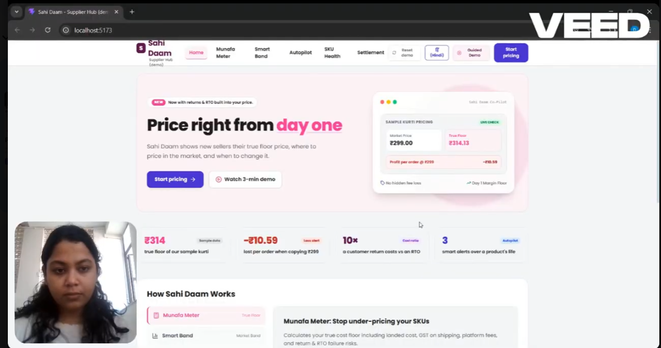
Impact & Pitfalls
Levers that turn the seller profitable, the prototype in action, and the pitfalls we mitigate
PROBLEM
SEGMENTATION
PRIORITISATION
BENCHMARKING
SOLUTION
MUNAFA METER
SMART BAND
AUTOPILOT
IMPACT
PITFALLS
Seller: levers turn the kurti profitable
−₹10.59 → +₹13.51
profit per dispatched order at the same ₹299 price, after three levers. Returns are the biggest lever: +1 point of returns costs 3.2× more than +1 point of RTO.
What is RPN?
Risk Priority Number = Likelihood × Impact × Detection
Each factor is scored 1–5, so RPN runs from 1 to 125.
Likelihood: how likely the pitfall is to happen
Impact: how badly it hurts sellers or Meesho
Detection: how hard it is to spot before damage (5 = hard)
Example: price herding 3 × 5 × 4 = 60 → after mitigation 2 × 4 × 2 = 16. Higher RPN = fix first.
LINK
Pitfalls & Mitigation
Before
After
Solution | Pitfall | RPN before | Mitigation built in | RPN after | Change
Munafa Meter | Wrong seller inputs → wrong floor | 48 | Category defaults and sanity ranges; weight check; settlement data corrects costs | 18 | −63%
 | Fee or slab changes make rates stale | 36 | Rate card read from live config; floor auto-recalculated | 4 | −89%
Smart Band | Price herding / CCI concern | 60 | Floor is seller-specific; band shown as a range; seller decides; no cost sharing; audit band drift | 16 | −73%
 | Category priors wrong for a niche SKU | 27 | 'Based on category data' label; own-data blending; launch screen | 12 | −56%
 | Buyer prices rise | 24 | Guardrail metric vs control; suggestions capped at band's upper quartile | 8 | −67%
Lifecycle Autopilot | Nudge fatigue / distrust | 27 | 3 triggers only; one nudge at a time; ₹ impact; easy opt-out | 8 | −70%
Sahi Daam overall | Low adoption: sellers ignore the tool | 32 | Default-on in listing flow; one-line ₹ answer; vernacular + voice | 16 | −50%
 | Seller data protection | 30 | Consent at first use; purpose-limited use; deletion on exit | 10 | −67%
5 |  | 1 | 1
4 |  | 1 | 1 | 2
3 |  |  | 2
2
1
 | 1 | 2 | 3 | 4 | 5
5 | 1
4 | 2 | 2
3 |  | 1 | 1
2 |  | 1
1
 | 1 | 2 | 3 | 4 | 5
Rows = impact (5 high) · columns = likelihood: pitfalls move down and left
35.5 → 11.5
Roadmap
Average RPN across 8 pitfalls (−68%)
Customer fraud checks (P11); pricing tickets verified before closing; band-shift and festive triggers
Notes:
Seller level from Workbook 05, season from Workbook 06, Meesho level from Workbook 07. We deliberately report net benefit on contribution margin, not revenue, because Meesho's revenue carries logistics costs.

Slide 11

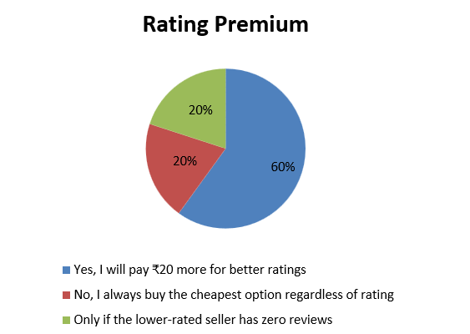
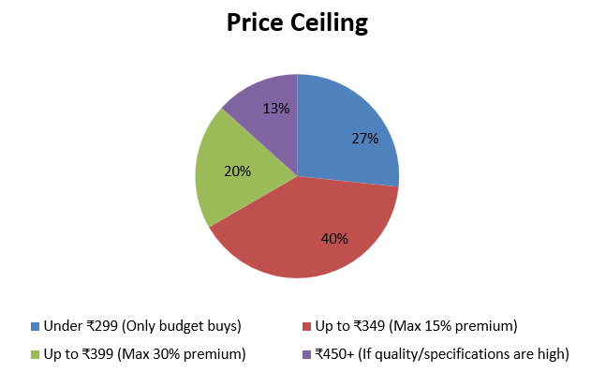
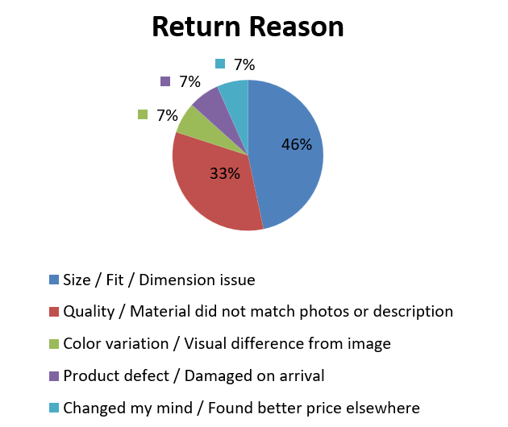
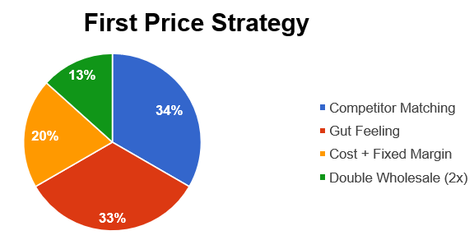
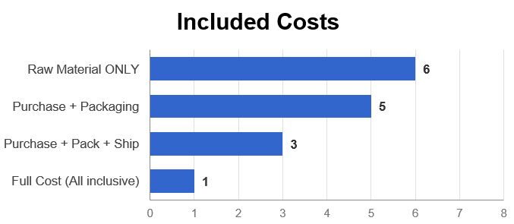
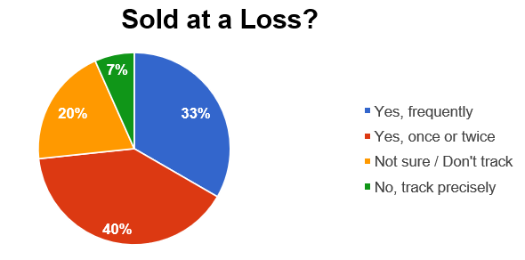
Appendix: Workbooks & Research
Every number comes from 6 linked Excel workbooks and our seller / buyer Google Form research
Assumptions
Floor Model
Market Band
Sensitivity
Lifecycle Simulation
Business Case & Pilot
Every input with low / base / high, source, confidence; category priors
Rate card, 5 SKUs, price → bank, weight check, keep / fix / drop
Listings, band & zones, suggested price, strategy, prior blending, launch test
Tornado, profit heat map, seller levers, returns vs RTO
26 weeks with vs without, 3 triggers
Funnel, ₹47 per order, 5-yr scenarios, pilot size, metrics tree
LINK
LINK
LINK
LINK
LINK
LINK
Primary research: Google Form results
How sellers set their first price
What sellers include in 'cost'
Ever sold at a loss without knowing?
Do ratings earn ₹20 more?
Price ceiling
Why buyers return
Seller form · supports P3, P2
Seller form · supports P1, P4
Seller form · supports P1, P4
Buyer form · supports Smart Band
Buyer form · market band
Buyer form · return lever (P4)
Mathematical results used
Key sources & Materials referred to:
Source Links
Floor: P₀ = C + S + (f·F + A)/(1 − f); profit per order = (1 − f)(P − P₀)
Break-even failure share: f* = (P − C − S − A)/(P − C − S + F)
Suggested price: min(max(ε/(ε − 1)·P₀, P₀), Q3)
Prior blending: weight on own data = n/(n + k), k = 30
Launch screen: P(X ≤ 10 | λ = 20) = 1.1%; ±5% price tests need 7,300+ views per group
Clearance floor: S + (f·F + A)/(1 − f) + salvage
Meesho FY26 results (961k ATS, 2.67 B orders, ₹12,626 Cr revenue); RHP (72% COD); IPO reviews (days to first order)
GoKwik, Unicommerce, ClickPost (RTO, returns, COD vs prepaid)
2026 Meesho seller-fee guides (to be confirmed); CBIC / Income-tax (TCS 0.5%, TDS 0.1%)
Ellison & Ellison (2009); Blattberg & George (1991); CCI AI & competition study (2025); DPDP Rules (2025)
https://drive.google.com/drive/folders/1q_5AnLlgQp4jQGbLFSIlKnrqhbQa5euM?usp=sharing - Research Docs
https://drive.google.com/file/d/17u93X0631TjChCc1Fbg0HvpnWAB2qHkl/view?usp=sharing –Prototype walkthrough
https://docs.google.com/spreadsheets/d/1vCXuHZ9pfYwaa5ab8PzH_oB2gRsz2IX0TM7K1WcqU6g/edit?usp=sharing – Seller Response form
https://docs.google.com/spreadsheets/d/1vzxZNOOE486r3gDiPDJrFr5em2Dd_QcVnyPAfdO1sVk/edit?usp=sharing – Buyer Response form
Notes:
Attach the 8 Excel files alongside the deck, or hyperlink each card to a shared-drive copy.

